Slide 1
Group 10
Sprint2

Slide 2
Progress
GANTT Chart
Front-end user interface (designs, fields and buttons)
Back-end (partial completion of coding)
Completion of the updated backend architecture
Database Relationship and keys (Primary and Foreign)
Update Admins JSP – for assigning a driver to demands, registering new customers and drivers, viewing all completed jobs
Update Customers JSP – for viewing invoice for journey, requesting a taxi, inputting needed details
Update Drivers JSP – for viewing job details and updating driver’s status
Presentation for Sprint 2

Slide 3
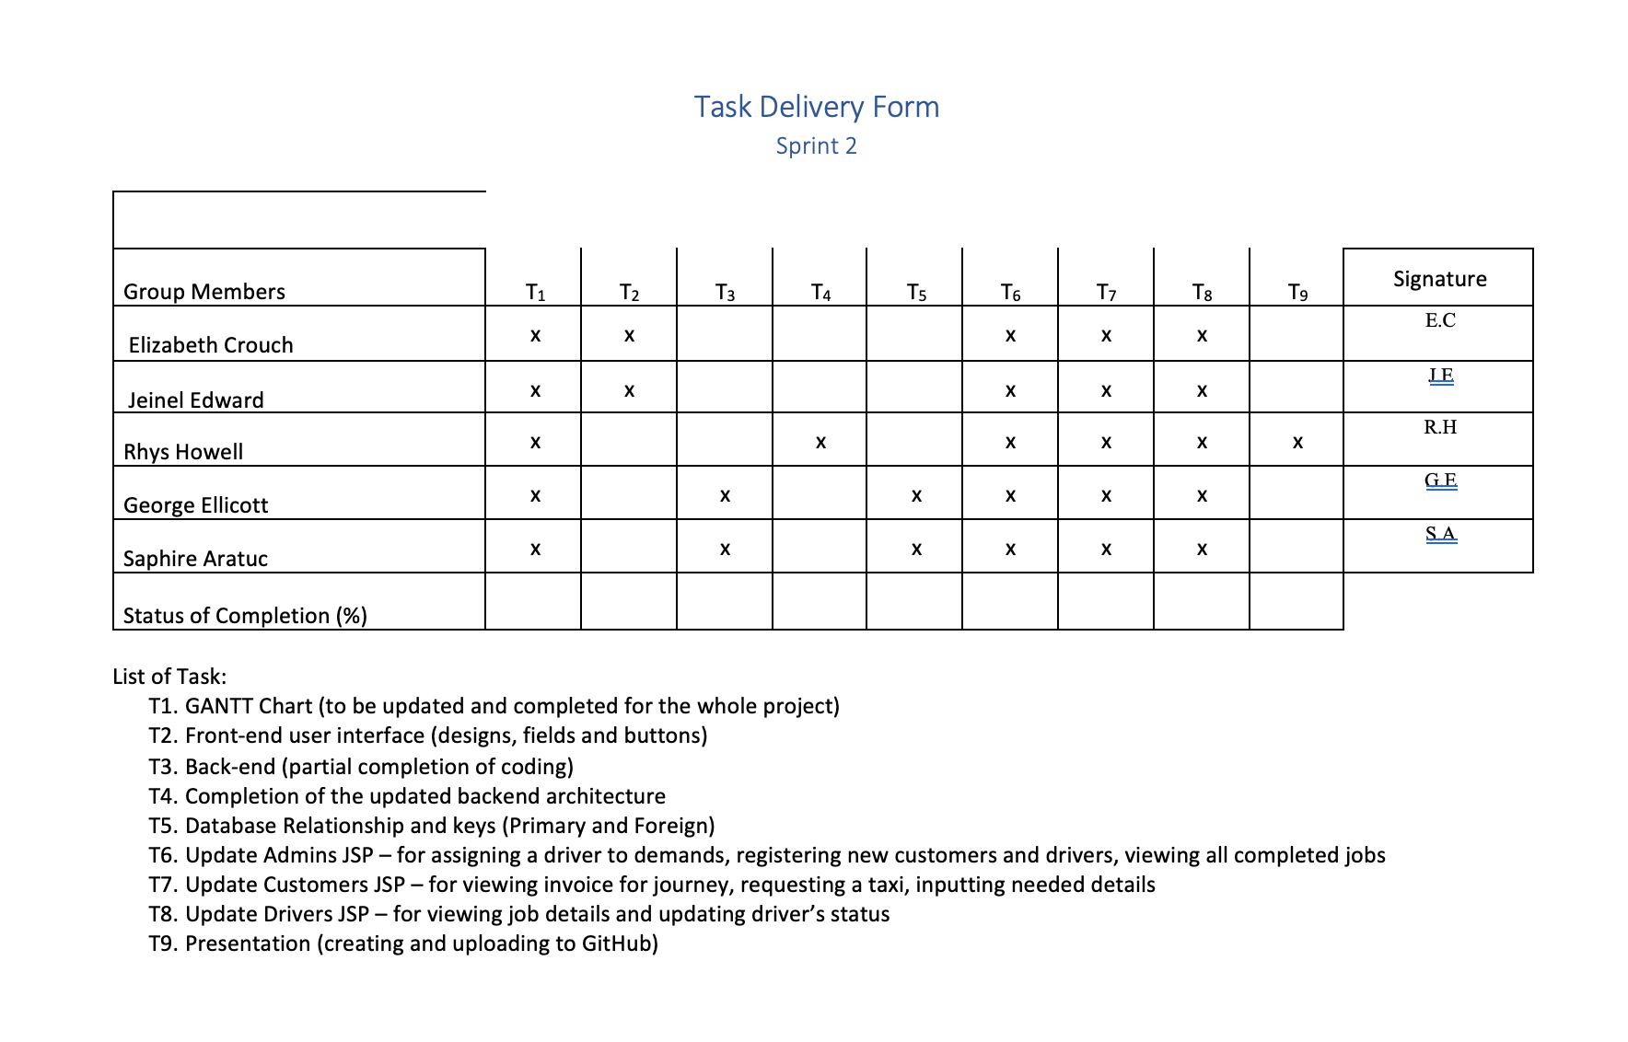
Roles and task Allocation

Slide 4
Planning and Scheduling (Gant Chart)

Slide 5
Scrum 1
Identify tasks for sprint 2 .
Allocate tasks to group members.
Created logo for website.
Continued development on front-end user interface

Slide 6
Scrum 2

Slide 7
Product backlog

